Slide 1
Welcome!
Join Code: No Square Cap Today
MiniPlay goes here.
‹#›

Slide 2
Day 12
3G.2 Procedural Decomposition w/ Graphics
CAROL RAMSEY
GDC 6.318
ramsey@cs.utexas.edu

Slide 3
Announcements
Our goal: Return exams in Section on Monday.
Y’all will have rubric, can ask questions, fill in the gaps.
Grading adjustments:
Are very rare.
Rubrics are reviewed and verified.
Only adjustments are for when there was a mistake in applying the rubric.
If you think there is a mistake, you must:
Notify the TA before you leave Section.
Return your test to the TA.
Email the TA during Section with a photo of the issue and why you think the rubric was applied incorrectly.
The TA will evaluate the request at a later time and send you and update.

Slide 4
What if I Didn’t Do Well?
Make adjustments
Amount of time or Quality Time?
The Basics - Lecture + Section + Practice Problems + Practice Tests
The Extras - Study Groups, Group Tutorials, Newbies
Sign up for Office Hours with me

Slide 5
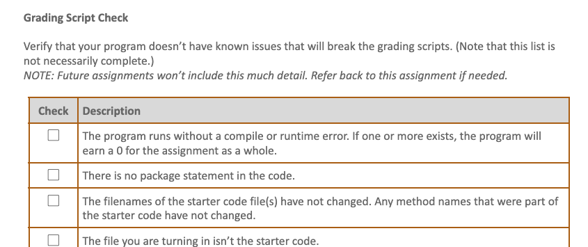
Programming Assignment Directions
Less detail, refer to Assignment 2 if needed.

Slide 6
3G.2
Procedural Decomposition with Graphics
Notes:
this is really still section 1

Slide 7
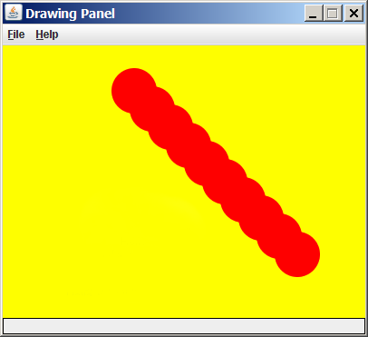
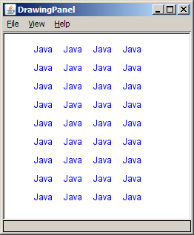
Drawing with Loops
The x,y,w,h expressions can use the loop counter variable:
panel.setBackground(Color.YELLOW);
g.setColor(Color.RED);
for (int i = 1; i <= 10; i++) {
// x y w h
g.fillOval(100 + 20 * i, 5 + 20 * i, 50, 50);
}
Nested loops can be used with graphics:
g.setColor(Color.BLUE);
for (int x = 1; x <= 4; x++) {
for (int y = 1; y <= 9; y++) {
g.drawString("Java", x * 40, y * 25);
}
}
‹#›

Slide 8
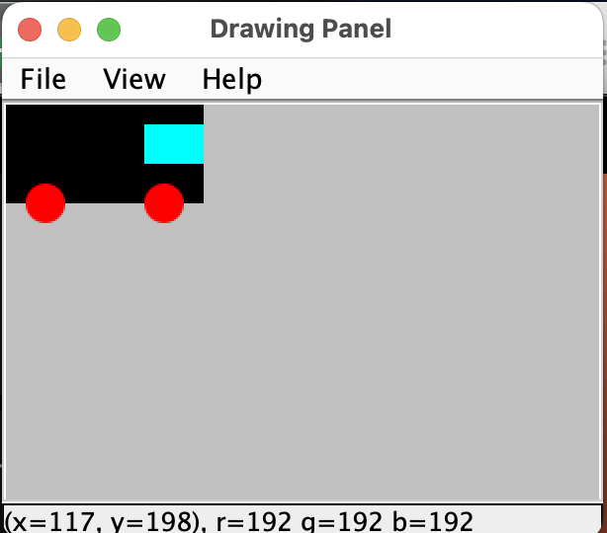
Day 12 Practice
‹#›
Notes:
‹#›

Slide 9
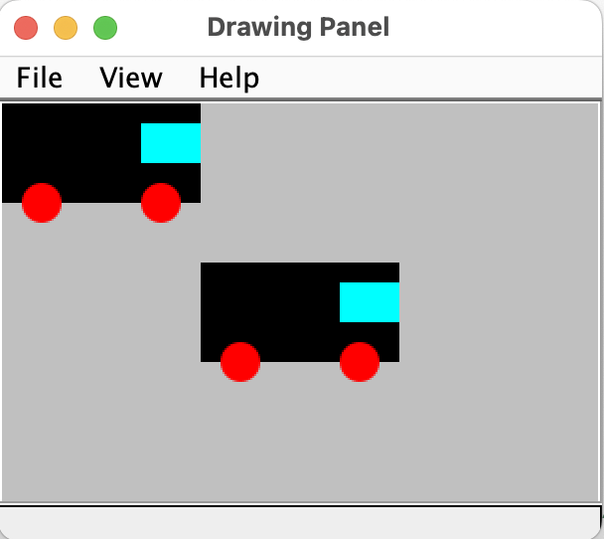
drawTruck1() - Parameterize Location
Truck Location |  | Large Rectangle |  | Small Rectangle |  | Left Wheel |  | Right Wheel
x | y | x | y | x | y | x | y | x | y
0 | 0 | 0 | 0 | 70 | 10 | 10 | 40 | 70 | 40
100 | 80
x | y | x | y | x+70
‹#›

Slide 10
drawTruck1() - Parameterize Location
Truck Location |  | Large Rectangle |  | Small Rectangle |  | Left Wheel |  | Right Wheel
x | y | x | y | x | y | x | y | x | y
0 | 0 | 0 | 0 | 70 | 10 | 10 | 40 | 70 | 40
100 | 80 | 100 | 80 | 170 | 90 | 110 | 120 | 170 | 120
x | y | x | y | x+70 | y+10 | x+10 | y+40 | x+70 | y+40
‹#›

Slide 11
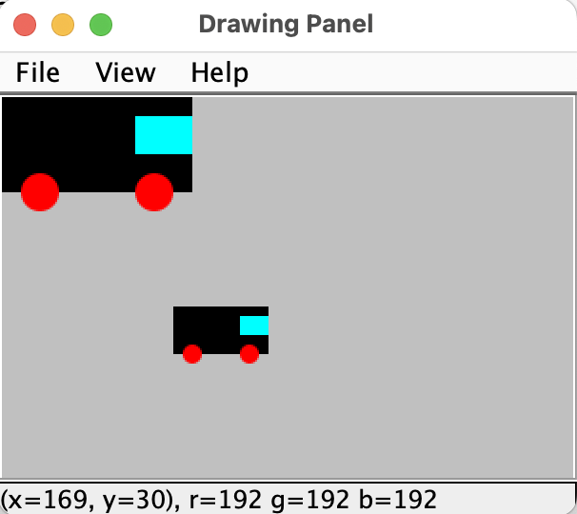
drawTruck2() - Parameterize Size
Truck Size | Large Rectangle |  | Small Rectangle |  | Left Wheel | Right Wheel
x | w | h | w | h | d | d
? | 100 | 50 | 30 | 20 | 20 | 20
‹#›

Slide 12
drawTruck2() - Parameterize Size
Truck Size | Large Rectangle |  | Small Rectangle |  | Left Wheel | Right Wheel
x | w | h | w | h | d | d
20 | 100 | 50 | 30 | 20 | 20 | 20
x=10 | 5x | 2.5x | 1.5x | x | x | x
‹#›

Slide 13
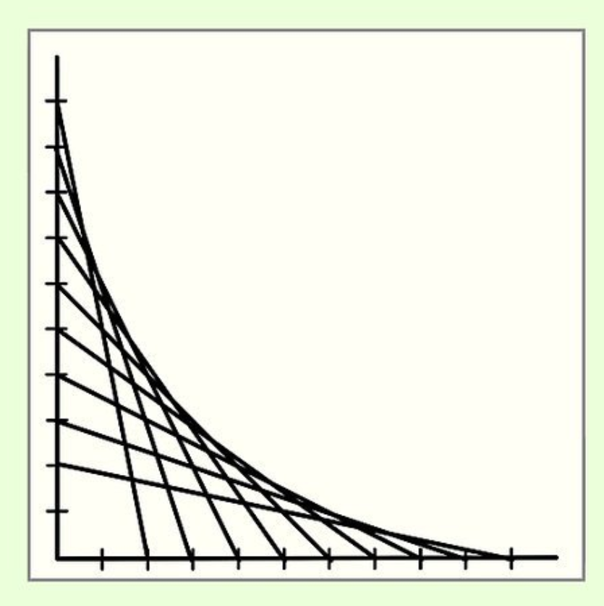
Graphics Example
Write a method that draws straight lines to create a shape with a curved appearance
Specify the x and y location of the upper left corner of the drawing and the size of the square to contain the drawing
‹#›

Slide 14
Panel Methods
Method Signature | Description
dp.setBackground(Color); | Sets color for the canvas.
panel.save(filename); | Saves the image on the panel to the given file (String).
panel.sleep(ms); | Pauses the drawing for the given number of milliseconds.
‹#›

Slide 15
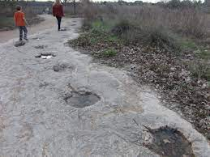
Austin Thought of the Day (Friday Only)
Olivia Chan
Cypress, Texas
There are dinosaur footprints in Leander that you can just walk right up to. Super cool little day trip to do with friends.
Photo courtesy of havingfuninthetexassun.com.

Slide 16
Remember
Test is one week from Wednesday, in the evening, 6:30-8:30pm, WEL 2.224.
‹#›

Slide 17
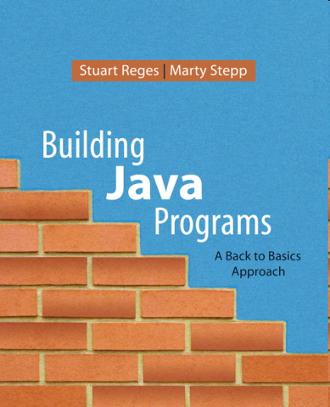
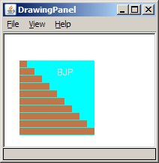
Java book figure - PRACTICE
Write a program that draws the following figure:
drawing panel is size 200x150
book is at (20, 35), size 100x100
cyan background
white "BJP" text at position (70, 55)
stairs are (red=191, green=118, blue=73)
each stair is 9px tall
1st stair is 10px wide
2nd stair is 20px wide ...
stairs are 10px apart (1 blank pixel between)
‹#›

Slide 18
Java book solution
// Draws a Building Java Programs textbook with DrawingPanel.
import java.awt.*;
public class Book {
public static void main(String[] args) {
DrawingPanel panel = new DrawingPanel(200, 150);
panel.setBackground(Color.WHITE);
Graphics g = panel.getGraphics();
g.setColor(Color.CYAN); // cyan background
g.fillRect(20, 35, 100, 100);
g.setColor(Color.WHITE); // white "bjp" text
g.drawString("BJP", 70, 55);
g.setColor(new Color(191, 118, 73));
for (int i = 0; i < 10; i++) { // orange "bricks"
g.fillRect(20, 35 + 10 * i, 10 + 10 * i, 9);
}
}
}
‹#›

Slide 19
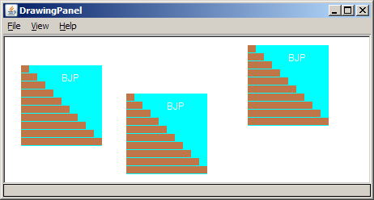
Multiple Java books
Modify the Java book program so that it can draw books at different positions as shown below.
book top/left positions: (20, 35), (150, 70), (300, 10)
drawing panel's new size: 450x180
‹#›

Slide 20
Multiple books solution
// Draws many BJP textbooks using parameters.
import java.awt.*;
public class Book2 {
public static void main(String[] args) {
DrawingPanel panel = new DrawingPanel(450, 180);
panel.setBackground(Color.WHITE);
Graphics g = panel.getGraphics();
// draw three books at different locations
drawBook(g, 20, 35);
drawBook(g, 150, 70);
drawBook(g, 300, 10);
}
...
‹#›

Slide 21
Multiple books, cont'd.
...
// Draws a BJP textbook at the given x/y position.
public static void drawBook(Graphics g, int x, int y) {
g.setColor(Color.CYAN); // cyan background
g.fillRect(x, y, 100, 100);
g.setColor(Color.WHITE); // white "bjp" text
g.drawString("BJP", x + 50, y + 20);
g.setColor(new Color(191, 118, 73));
for (int i = 0; i < 10; i++) { // orange "bricks"
g.fillRect(x, y + 10 * i, 10 * (i + 1), 9);
}
}
}
‹#›

Slide 22
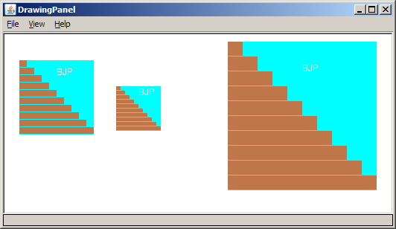
Resizable Java books
Modify the Java book program so that it can draw books at different sizes as shown below.
book sizes: 100x100, 60x60, 200x200
drawing panel's new size: 520x240
‹#›

Slide 23
Resizable books solution
// Draws many sized BJP textbooks using parameters.
import java.awt.*;
public class Book3 {
public static void main(String[] args) {
DrawingPanel panel = new DrawingPanel(520, 240);
panel.setBackground(Color.WHITE);
Graphics g = panel.getGraphics();
// draw three books at different locations/sizes
drawBook(g, 20, 35, 100);
drawBook(g, 150, 70, 60);
drawBook(g, 300, 10, 200);
}
...
‹#›

Slide 24
Resizable solution, cont'd.
...
// Draws a book of the given size at the given position.
public static void drawBook(Graphics g, int x, int y, int size) {
g.setColor(Color.CYAN); // cyan background
g.fillRect(x, y, size, size);
g.setColor(Color.WHITE); // white "bjp" text
g.drawString("BJP", x + size/2, y + size/5);
g.setColor(new Color(191, 118, 73));
for (int i = 0; i < 10; i++) { // orange "bricks"
g.fillRect(x, // x
y + size/10 * i, // y
size/10 * (i + 1), // width
size/10 - 1); // height
}
}
}
‹#›

Slide 25
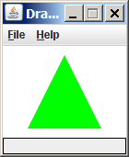
Polygon
Objects that represent arbitrary shapes
Add points to a Polygon using its addPoint(x, y) method.
Example:
DrawingPanel p = new DrawingPanel(100, 100);
Graphics g = p.getGraphics();
g.setColor(Color.GREEN);
Polygon poly = new Polygon();
poly.addPoint(10, 90);
poly.addPoint(50, 10);
poly.addPoint(90, 90);
g.fillPolygon(poly);
‹#›

Slide 26
Remember
You Belong Here
No

